Slide 1
The People Factor: How Climate Change Alters It’s Own Forecasts by James Lee, American University November, 2014

Slide 2
I. What are Climate Forecast Assumptions?
Temperature patterns showing a gradual rise globally; less certain are precipitation forecasts
Significant regional variation, especially in rainfall
More warming in the north than south
Lots of surface water at the poles; less at the equator
Trends do not stop at 2100, warming will continue for centuries

Slide 3
Temperature Forecast, 2100 (AR4)

Slide 4
Precipitation Forecast, 2100 (AR4)

Slide 5
IPCC Model Scenarios and Input Assumptions (AR4)
A1 Markets (Pro-Business, more rapid Globalization)
A2 Regions (Disaggregate regional approaches, somewhat baseline)
B1 Green (Focus on alternative energy, low population)
B2 Sustainable (sort of a mix of Markets and Green)
Difference in 50 versus 100 year reliability
Temperature and precipitation are major indicators

Slide 6
Scenario Assumptions + Outputs (AR4)

Slide 7
Population Projections Used in AR4

Slide 8
IPCC AR5 Report 2013
AR5 Release shows more temperature rise and higher sea levels than AR4.
Scenarios are 4 Types of Representative Concentration Pathways (RCPs)
RCP Types are based on levels of radiative forcing (RF) or heat gain and loss. RF atmospheric measurements capture gains and losses in planetary radiative forces.
First report to address human security issues.

Slide 9
Dimensions of Climate Change in AR5

Slide 10
Temperature in Climate Scenarios (AR4)

Slide 11
Temperature in Climate Scenarios, (AR5)

Slide 12
Links between Society and Climate
1. Where will climate change have the most impact on people? Very regional with winners and losers.
2. How will human activity interact with the forecasts and alter them? Where is the feedback back from climate to society?
3. Long term implications of human impacts on climate change and Agricultural Revolution impact over eons (Ruddiman hypothesis)

Slide 13
II. The Role of People in Climate Forecasts
How do population and social trends align and impact with climate trends? There is no social feed back into climate models.
Alignment of Trends around 2050: The Demographic-Climate Convergence
Trends will alter national power capabilities due to substantial demographic and resource shifts
Changes in sovereignty; oceanic claims and Antarctica, North Pole Passage, melting glaciers, drying and moving rivers, and shifting EEZs. (Note Border Paper.)

Slide 14
Climate Feedback: Three Questions
Climate models fail to fully account for feedback that may accelerate or slow rates of climate change, or make adaptation more difficult.
(1) Why is it happening? Continuing reliance on agricultural sector for employment and income.
(2) Who? By mid-century, Sub-Saharan Africa and South Asia will become the majority population.
(3) When? Feedback from climate change will push the date of global demographic transition farther into the future, adding billions more to projections.

Slide 15
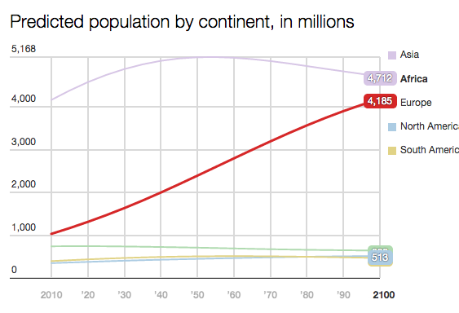
Focus on Key Demographic Trends
Max Fisher, “The amazing, surprising, Africa-driven demographic future of the Earth, in 9 charts”, July 16, 2013, Washington Post, All data from the United Nations

Slide 16
The Biggest Countries in 2100

Slide 17
Developed Country Projections

Slide 18
The New Work Force

Slide 19
Recent Population Projections
UN and U. Wash recent projection used statistical trends rather than expert opinions to estimate population trends (Sept. 2014)
Birth rates have not fallen recently; remained stagnant in the developing world or not fallen as fast as anticipated.
Rather than leveling off mid-century, population will continue to grow past 2100
New range estimates are of population in 2100: 9-13 billion
In Africa demographic transition is not occurring and by 2100, 4 billion will live there. About one-third of all people.

Slide 20
III. Hot and Cold Wars

Slide 21
Future Conflicts (DOD, out to 2015)

Slide 22
Deaths from Conflicts (1945-today) SIPRI

Slide 23
Explanations for climate and conflict behavior
Fully and Empty Belly war theories. Too much or too little food leads to conflict?
Too much of either precipitation or temperature can be a problem, if it occurs at the wrong time.
Marshall Burke finds more of a link to temperature. It is more predictable. Short-term impacts, no significant lags over time. You gradually go hungry over many years.
Burke estimates that by 2030 an additional 393,000 battle deaths in Sub-Sahara Africa due to increasing temperatures.

Slide 24
State Failures

Slide 25
Forecast Rainfall Deficits in Africa

Slide 26
Population Densities in Africa

Slide 27
Key River Systems and Likely Conflict Points

Slide 28
The Climate Forecast Termites
1. Slowing in Agricultural Productivity
2. Stalling of Economic Growth and Demographic Transition
3. High Population Growth Rates Persist, adding millions, in Africa and South Asia
4. Weak government institutions cannot manage adaptation.
5. There will be a hard rather than a soft landing of climate and demographic forces. Sets the stage for conflict.

Slide 29
IV. Serenity and Chaotica
1. New Bi-Polar System 2. Symptom of growing global inequality
3. Shadows shifting global power distributions
4. A historical track, centuries in the making 5. Pockets of Cross-Over

Slide 30
The Two Worlds: Serenity and Chaotica

Slide 31
Chaotica Regions: Differing Projections

Slide 32
Relative Climate Vulnerability in Chaotica
Region Vulnerability in Africa
1. South Asia (SAS): Extreme
2. Central Asia (CA): Medium
3. Middle East (ME): Medium
4. North Africa (NA): Medium
5. West Africa (WA): Extreme
6. East Africa (EA): Extreme
7. Middle Africa (MA): Extreme
8. South Africa (SAF): Low

Slide 33
Climate Change and Conflict in the Anthropocene Era
1. Growing Inequality will be increased by Climate Change
2. Including feedback will change climate forecasts
3. The soft landing window has probably closed.
4. Adaptation will only be possible in some places.
5. Our impact on climate cycles in the long-term. Did we already delay an Ice Age?
6. Some say the Anthropocene Era will last 10-50,000 years.

Slide 34
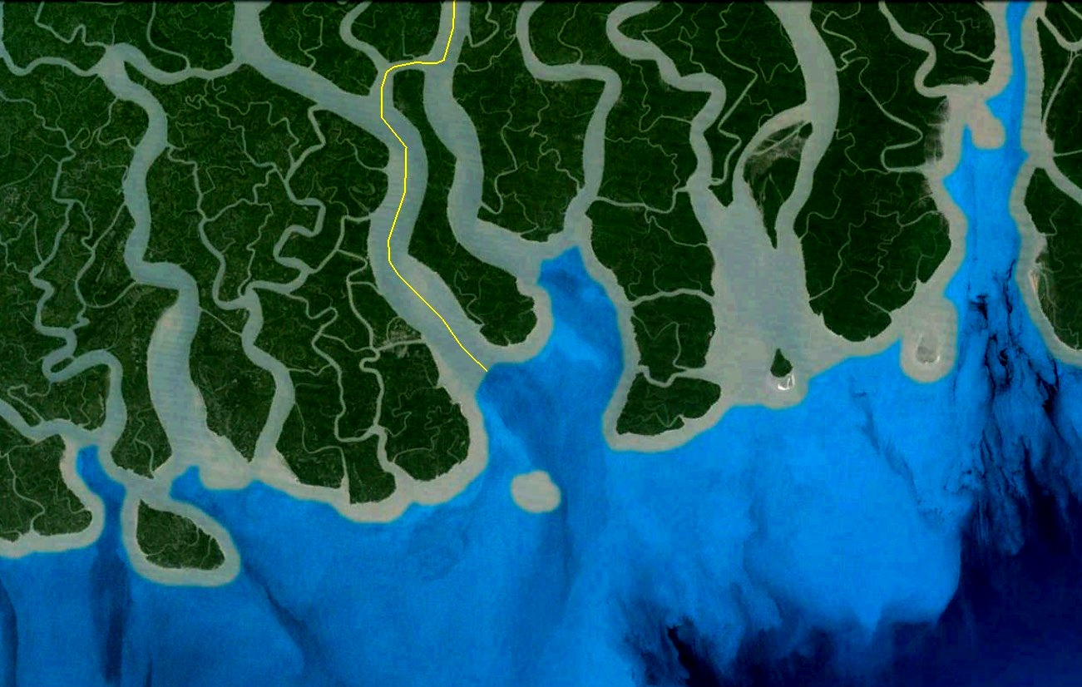
New Moore, or South Talpatti (1971 – 2010)

Slide 35
New Moore, or South Talpatti (1971 – 2010)

Slide 36
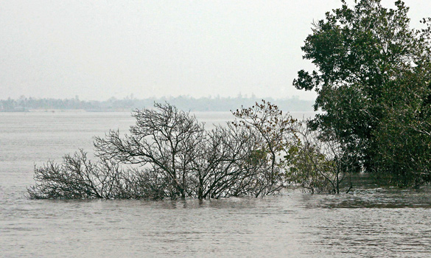
New Moore, or South Talpatti (1971 – 2010)
Last known photograph of New Moore / South Talpatti island, taken in 2009

Slide 37
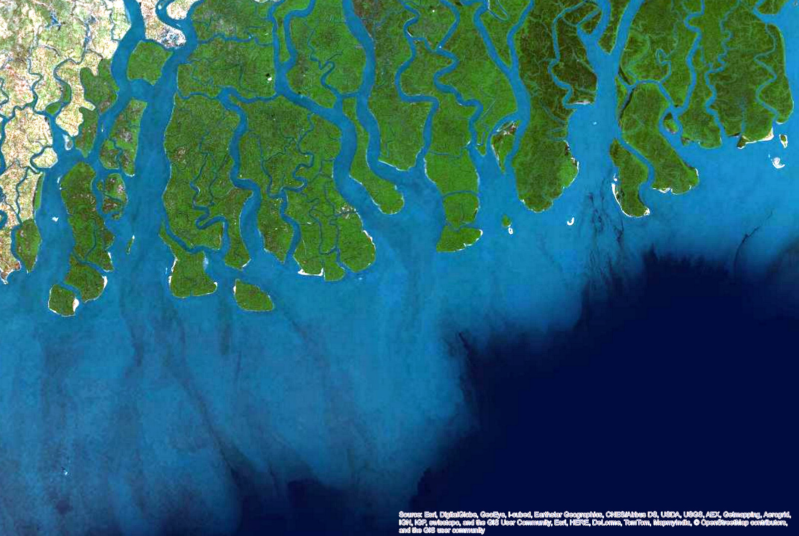
New Moore, or South Talpatti (1971 – 2010)

Slide 38
Maritime dispute in Bay of Bengal

Slide 39
De-limitation of the Bangladesh-Myanmar Maritime Border - 2011

Slide 40
De-limitation of the Bangladesh-Myanmar Maritime Border - 2011
Notes:
This verdict thus validated Bangladesh’s demand for equity-based demarcation as per UNCLOS 74 and 83.

Slide 41
De-limitation of the Bangladesh-Myanmar Maritime Border - 2012

Slide 42
De-limitation of the Bangladesh-India Maritime Border - 2014
Ruled by the permanent court of arbitration (PCA)
Bangladesh awarded 4/5th of the total maritime area it had claimed
19,467 / 25,602 sq km.
India awarded the control over the now disappeared island

